Slide 1
Rwanda SAM Toolkit Standardized Approach to Building & Updating SAMs
Emerta Aragie and James Thurlow
Recap Session | 30 Oct 2020

Slide 2

SAM-Building Toolkit
Reconciles data from multiple sources
Core toolkit tailored to national statistical reports
Final data reconciliation uses cross-entropy estimation
Coded in Microsoft Excel® and GAMS®
Macro data
Input-output table
Micro data
National accounts (SNA 2008)
Balance of payments (IMF BOP6)
Gov. finance (IMF GFSM2014)
Rebased national accounts
Agriculture censuses + surveys
Industrial firm surveys
Agriculture production (FAOSTAT)
Industrial + economic surveys
Energy balance (IEA)
Trade flows (COMTRADE)
Tariffs (TRAINS)
Labor force surveys
Household surveys (LSMS)

Slide 3
Process
Step 1: Macro SAM
Single aggregate activity, commodity, labor and household accounts
Step 2: Supply-Use Table
Disaggregate and balance activity and commodity accounts
Step 3: Income Distribution
Disaggregate and balance labor and household accounts

Slide 4
Toolkit Files
Estimate SUT Coefficients (workings folder)
Step 1
Step 2
Build and Balance 1national.gms 2balance.gms
Prior National SAM 1national.xlsx
Excel: Build Macro SAM; split activities & commodities
GAMS: Press F9
Process survey data (surveys folder)
Step 4
Step 3
Build and Balance 3household.gms 4balance.gms
Prior Household SAM 3household.xlsx
Excel: Split households
GAMS: Press F9
Balanced SAMs (0output.xlsx)

Slide 5
Step 1: Macro SAM
Constructing aggregate accounts

Slide 6
Data Sources
Three main data sources:
National Accounts (activity and commodity accounts)
Government Financial Statistics (spending and tax accounts)
Balance of Payments (external account)
Standardized concordance between SAM and classification systems
GFS2014 & BOP6 → SNA 2008 → Macro SAM accounts
Inconsistent values across sources requires reconciliation:
Consistency with national accounts afforded highest priority, followed by BOPs and then GFS

Slide 7
Entries
 | Act | Com | Fact | Ent | Hhd | Gov | Tax | S-I | Stk | Wld | Tot
Activities |  | NA |  |  |  |  |  |  |  |  | NA
Commodities | NA |  |  |  | NA | NA |  | NA | NA | NA | NA
Factors | NA |  |  |  |  |  |  |  |  | BOP | X
Enterprises |  |  | X |  |  | GFS |  |  |  | BOP | X
Households |  |  | X | X |  | GFS |  |  |  | BOP | X
Government |  |  | GFS | GFS | GFS |  | GFS |  |  | BOP | GFS
Taxes | NA | NA | GFS | GFS | GFS |  |  |  |  |  | GFS
Savings |  |  |  | ? | X | GFS |  |  |  | BOP | X
Stock change |  |  |  |  |  |  |  | NA |  |  | X
Rest of world |  | NA | BOP | BOP | BOP | BOP |  |  |  |  | BOP
Total | NA | NA | X | X | X | GFS | GFS | NA | NA | BOP
NA National Accounts
GFS Government Financial Statistics
BOP Balance of Payments
X Convention or residual

Slide 8
Details
 | Act | Com | Fact | Ent | Hhd | Gov | Tax | S-I | Stk | Wld | Tot
Activities
Commodities
Factors
Enterprises
Households
Government
Taxes
Savings
Stock change
Rest of world
Total
Factors
Labor | Land | Capital
Taxes
Activities (producer) | Export duties | Import duties | Sales or VAT | Factor | Direct

Slide 9
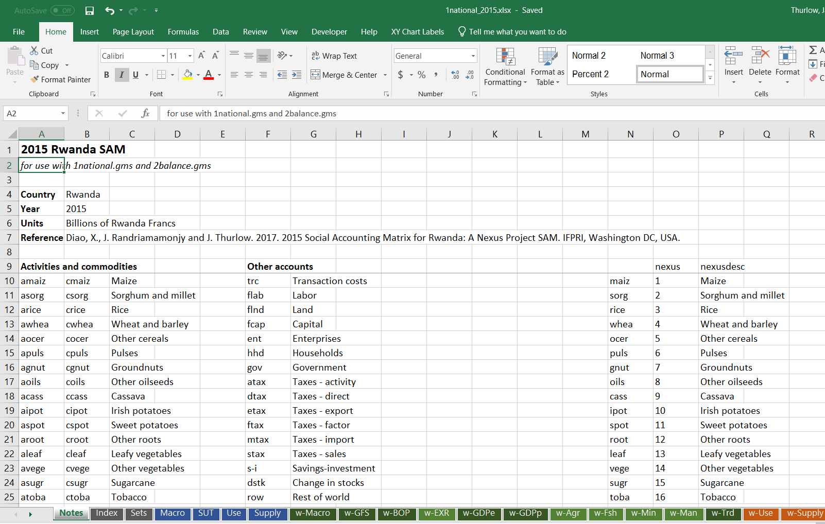
Opening National SAM Excel File
1national.xlsx | Notes

Slide 10
Worksheet Names
Black & gray sheets
Notes and GAMS parameters
Blue sheets
Final data imported directly into GAMS
Green sheets
Working sheets with original data, transformed into GAMS-ready formats
Updated frequently (every year) – national accounts, trade flows, etc.
Orange sheets
Working sheets with original data
Updated less frequently (every few years) – survey data, SUT coefficients

Slide 11
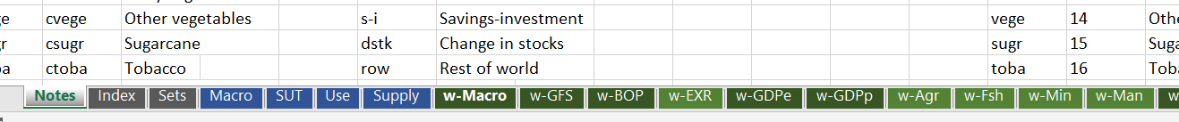
Macro SAM Sheets
w-GFS Government Financial Statistics
w-BOP Balance of Payments
w-GDPe National Accounts (GDP expenditure-side)
w-GDPp National Accounts (GDP production-side)
w-Macro Consolidation sheet for balancing Macro SAM
Macro Final Macro SAM imported into GAMS
1national.xlsx | Notes

Slide 12
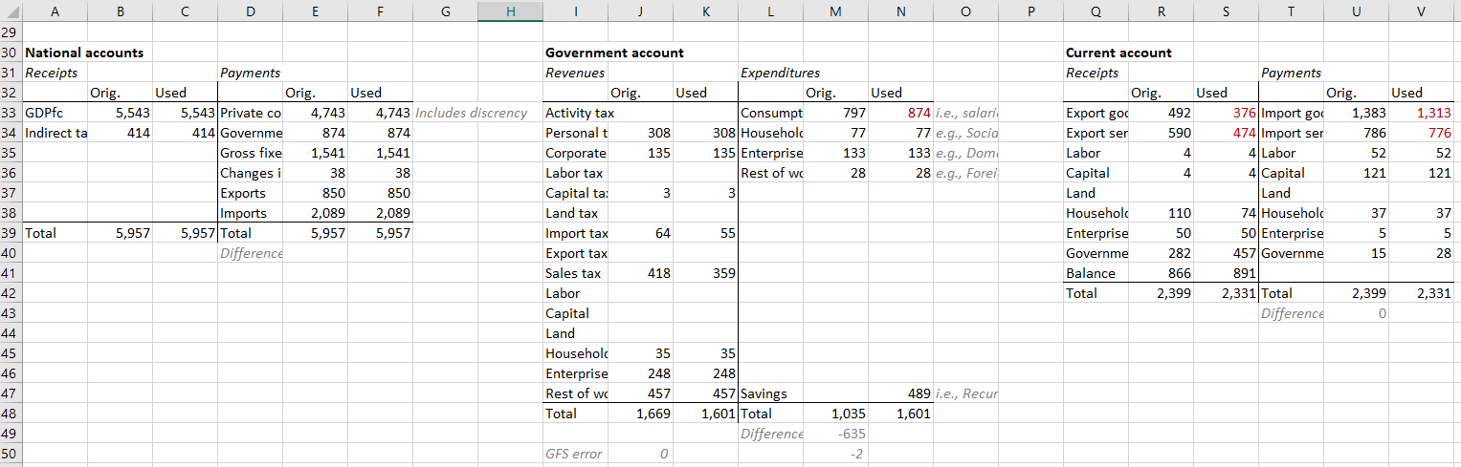
Creating Macro T-Accounts
Assign detailed NA, BOP and GFS data to Macro SAM accounts
Following classification guidelines from SNA2008
Double-entry bookkeeping (receipts vs. payments)
1national.xlsx | w-Macro

Slide 13
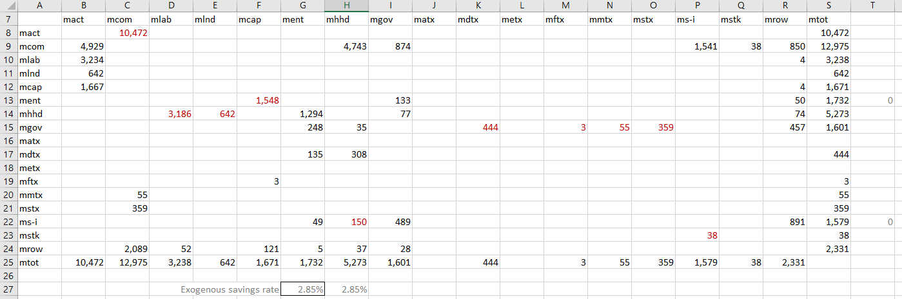
Final Macro SAM
Square matrix (rows = columns)
Aggregate accounts (1 activity, 1 commodity, 1 households)
Detailed factors (labor, land, capital) and taxes (activity, direct, export, import, sales)
Manually separate private savings between households and enterprises
1national.xlsx | w-Macro

Slide 14
Step 2: Supply-Use Table
Disaggregating activities and commodities

Slide 15
Details
 | Act | Com | Fact | Ent | Hhd | Gov | Tax | S-I | Stk | Wld | Tot
Activities
Commodities
Factors
Enterprises
Households
Government
Taxes
Savings
Stock change
Rest of world
Total
117 activities + 117 commodities

Slide 16
Rwanda Activities & Commodities
Agricultural Sectors & Products
35
Maize | Sorghum + millet | Rice | Wheat + barley | Other cereals | Pulses | Groundnuts | Other oilseeds | Cassava | Irish potatoes | Sweet potatoes | Other roots | Leafy vegetables | Other vegetables | Sugarcane | Tobacco | Cotton + fibers | Nuts | Bananas + plantains | Other fruits | Tea | Coffee | Cocoa | Cut flowers | Rubber | Other crops | Cattle | Raw milk | Poultry | Eggs | Sheep + goats | Other livestock | Forestry | Aquaculture | Capture fisheries
Industrial Sectors & Products
51
Coal and lignite | Crude oil | Natural gas | Metal ores | Quarry and other mining products | Meat and meat products | Prepared and preserved fish | Dairy products | Prepared and preserved vegetables | Animal and vegetable oils and fats | Milled maize products | Milled sorghum and millet products | Milled rice products | Milled wheat and barley products | Other milled grain products | Sugar refining | Coffee processing |Tea processing | Bakery products| Other foods | Animal feed & other by-products | Alcoholic drinks | Soft drinks | Tobacco products | Cotton yarn | Textiles | Clothing | Leather and footwear | Wood and related products | Paper and related products | Printing and reproduction of recorded media | Coke and refined | petroleum products | Fertilizers and herbicides | Pharmaceutical products | Rubber and plastics products | Other chemicals and chemical products | Other non-metallic mineral products | Manufacture of cement, lime and plaster | Manufacture of clay building materials | Metals & metal products, except machinery and equipment | Machinery (except transport) | Electrical machinery | Transport equipment (incl. vehicles) | Furniture | Other manufacturing | Repair and installation of machinery and equipment | Electricity, gas, steam and air conditioning supply | Water collection, treatment and supply: sewage | Waste collection and management | Construction (modern) | Construction (traditional)
Service Sectors & Products
31
Maintenance and repair of motor vehicles | Wholesale and retail trade of motor vehicles and motorcycles | Wholesale trade, except of motor vehicles and motorcycles | Retail trade, except of motor vehicles and motorcycles | Land transport | Air transport | Services related to transport | Postal and courier activities | Accommodation | Restaurants and food services | Publishing, video making, programming & broadcasting activities | Telecommunication | Information technology services | Monetary institutions | Insurance, reinsurance and pension funding, except compulsory social security | Other financial services | Rental value of dwellings | Other real estate activities | Legal, accounting management & head office activities | Architectural and engineering activities | Other professional, scientific and technical activities | Travel agents and tour operators | Other administrative and support service activities | Public administration and defence; compulsory social security | Education | Human health activities | Social work activities | Libraries, archives, museums and other cultural activities | Other arts, entertainment and recreation | Domestic services | Other service activities

Slide 17
Data Sources
Main data sources:
National accounts (GDP by sector, trade margins)
Agricultural and industrial production data and surveys
Input-output table
Trade and tax data (esp. VAT and customs duties)
Household expenditure survey (consumption demand vector)
Standardized concordance between SAM and classification systems
ISIC3.1, ISIC4, HS2007, COICOP → Disaggregated SAM accounts
Inconsistent values across sources requires reconciliation:
Balanced using cross-entropy techniques in GAMS®

Slide 18
Entries
 | Act | Com | Fact | Ent | Hhd | Gov | Tax | S-I | Stk | Wld | Tot
Activities |  | SUT
Commodities | SUT | SUT |  |  | SVY | GFS |  | NA | NA | TRD
Factors | SVY
Enterprises
Households
Government
Taxes | GFS | GFS
Savings
Stock change
Rest of world |  | TRD
Total
SUT Supply-Use Table
GFS Government Financial Statistics
SVY Household & firm surveys
TRD Customs trade data

Slide 19
Process
Generate input-output table (see Workings Folder)
Split GDP by sector (w-GDPp)
Use sector production and price data to go beyond national accounts
Map import & export data to SAM accounts (w-TRD)
Combine with services trade data from BOP6
Estimate consumption & investment demand vectors (w-ABS)
Use latest household survey for private consumption demand
Estimate tax rates & transaction cost margins (w-TAX, w-TRC)

Slide 20
SUT Sheets
w-GDPp GDP at factor cost by sector
w-AGR Agriculture production data (FAOSTAT)
w-FSH Fisheries production data (FISHSTAT)
w-MIN Mining production data
w-MAN Manufacturing production data
w-TRD Imports and Exports (X + M)
w-ABS Absorption vectors (C + I + G)
w-TAX Indirect taxes on producers & products
w-TRC Transaction cost margins
SUT Final supply-use table imported into GAMS
1national.xlsx | Notes

Slide 21
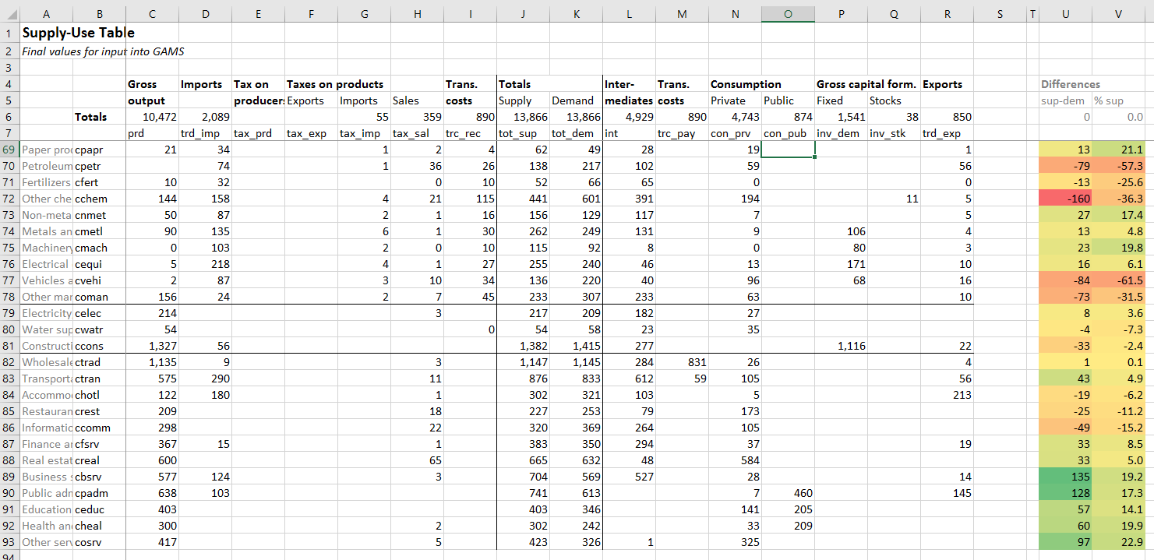
Supply-Use Table
Supply
Demand
1national.xlsx | w-SUT

Slide 22
Toolkit Files
Estimate SUT Coefficients (workings folder)
Step 1
Step 2
Build and Balance 1national.gms 2balance.gms
Prior National SAM 1national.xlsx
Excel: Build Macro SAM; split activities & commodities
GAMS: Press F9
Process survey data (surveys folder)
Step 4
Step 3
Build and Balance 3household.gms 4balance.gms
Prior Household SAM 3household.xlsx
Excel: Split households
GAMS: Press F9
Balanced SAMs (0output.xlsx)

Slide 23
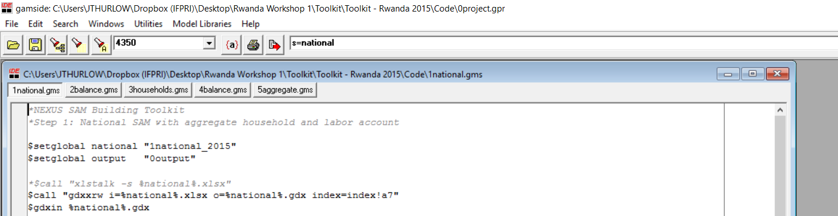
Building the SAM in GAMS
Create a GAMS project file (0project.gpr)
Open all GAMS files (from 1national.gms to 5aggregate.gms)
Click on national SAM build file (1national.gms)
Check that you are using the correct data file (1national_2015)
Press F9 (or click on Run Button)
1national.gms

Slide 24
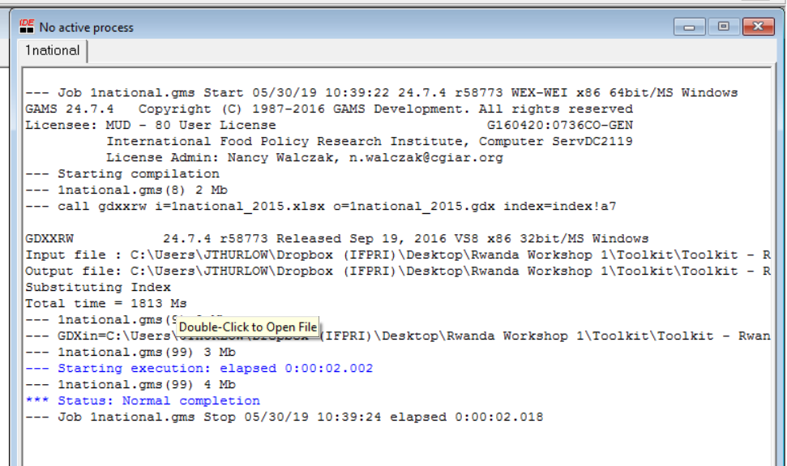
Checking GAMS Process Window
Check the Process Window that GAMS was run successfully
Normal Completion
No “Division by Zeros” or other errors

Slide 25
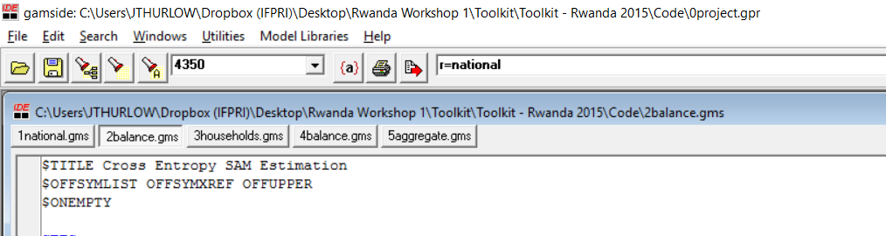
Balancing the SAM in GAMS
Click on SAM balancing file (2balance.gms)
Check you are restarting from the previous file (r=national)
Press F9 (or click on Run Button)
2balance.gms

Slide 26
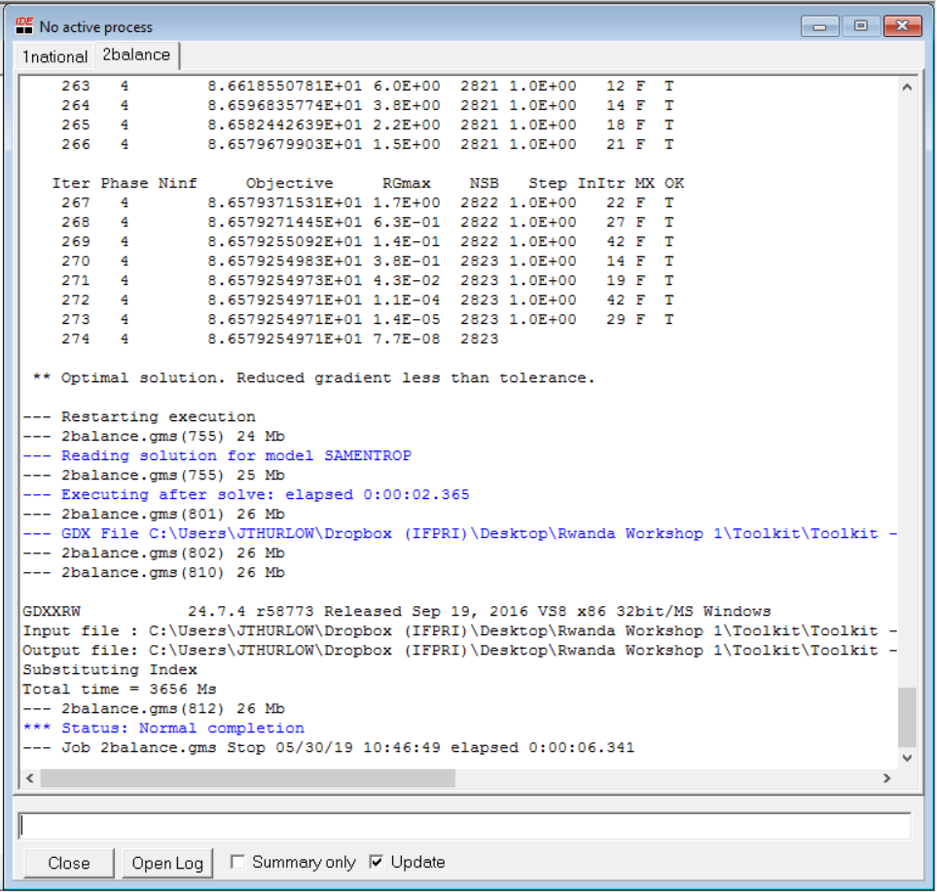
Checking GAMS Process Window
Check Process Window that GAMS was run successfully
Optimal solution
Normal Completion
No errors in exporting to Microsoft Excel

Slide 27
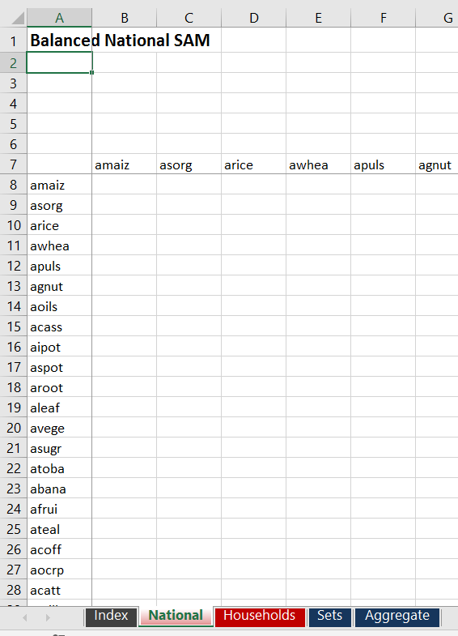

Viewing Balanced National SAM
0output.xlsx | National sheet
Balanced SAMs are exported to the 0output.xlsx file
SAM data sheets
Balanced National SAM (national)
Balanced Household SAM (households)
Aggregated SAM (aggregate)

Slide 28
Balancing SAMs (1)
One approach is to use the RAS method
Rows and columns are uniformly scaled in iteration until totals converge
Advantages: Simple to implement (even in Excel)
Shortcoming: Can do significant “damage” to the original data (make adjustments to cells, even if they are not causing the imbalance)
 | Act | Com | Fact | Ent | Hhd | Gov | Tax | S-I | Stk | Wld | Tot
Activities |  |  |  |  |  |  |  |  |  |  | X
Commodities |  |  |  |  |  |  |  |  |  |  | X
Factors |  |  |  |  |  |  |  |  |  |  | X
Enterprises |  |  |  |  |  |  |  |  |  |  | X
Households |  |  |  |  |  |  |  |  |  |  | X
Government |  |  |  |  |  |  |  |  |  |  | X
Taxes |  |  |  |  |  |  |  |  |  |  | X
Savings |  |  |  |  |  |  |  |  |  |  | X
Stock change |  |  |  |  |  |  |  |  |  |  | X
Rest of world |  |  |  |  |  |  |  |  |  |  | X
Total | X | X | X | X | X | X | X | X | X | X

Slide 29
Balancing SAMs (2)
Better approach is to use the cross-entropy method
Each cell is adjusted individually (rather than entire rows & columns)
Minimize deviation from original data (using error distributions)
Advantages: Focus more on cells that are causing imbalances
Shortcoming: More complex (need GAMS rather than just Excel)
 | Act | Com | Fact | Ent | Hhd | Gov | Tax | S-I | Stk | Wld | Tot
Activities |  |  |  |  |  |  |  |  |  |  | X
Commodities |  |  |  |  |  |  |  |  |  |  | X
Factors |  |  |  |  |  |  |  |  |  |  | X
Enterprises |  |  |  |  |  |  |  |  |  |  | X
Households |  |  |  |  |  |  |  |  |  |  | X
Government |  |  |  |  |  |  |  |  |  |  | X
Taxes |  |  |  |  |  |  |  |  |  |  | X
Savings |  |  |  |  |  |  |  |  |  |  | X
Stock change |  |  |  |  |  |  |  |  |  |  | X
Rest of world |  |  |  |  |  |  |  |  |  |  | X
Total | X | X | X | X | X | X | X | X | X | X

Slide 30
Cross-Entropy
Each cell in the SAM is assigned a range & error distribution
Impose a penalty whenever cell data deviates from original value
Penalty gets exponentially worse the further the deviation
Normal distribution
Uniform distribution
Lower bound
Initial cell value
Upper bound

Slide 31
Three Types of Controls
We can impose three controls or constraints on the solution
Row & column totals: Equalize
Cell values: Maintain original values
Macro controls: Maintain original sum of groups of cells
CE minimizes errors arising if constraints cannot be met
 | Act | Com | Fact | Ent | Hhd | Gov | Tax | S-I | Stk | Wld | Tot
Activities |  |  |  |  |  |  |  |  |  |  | X
Commodities |  |  |  |  |  |  |  |  |  |  | X
Factors |  |  |  |  |  |  |  |  |  |  | X
Enterprises |  |  |  |  |  |  |  |  |  |  | X
Households |  |  |  |  |  |  |  |  |  |  | X
Government |  |  |  |  |  |  |  |  |  |  | X
Taxes |  |  |  |  |  |  |  |  |  |  | X
Savings |  |  |  |  |  |  |  |  |  |  | X
Stock change |  |  |  |  |  |  |  |  |  |  | X
Rest of world |  |  |  |  |  |  |  |  |  |  | X
Total | X | X | X | X | X | X | X | X | X | X

Slide 32
Rwanda SAM Macro Controls
Total labor, land & capital value-added
Tax revenue collections for each tax type (e.g., VAT, excise, custom duties)
Inter-institutional transfers (e.g., government, households, enterprises, rest of world)
Total value-added in sector groupings (i.e., AGR, MIN, MAN, UTL, CON, etc.)
 | Act | Com | Fact | Ent | Hhd | Gov | Tax | S-I | Stk | Wld | Tot
Activities |  |  |  |  |  |  |  |  |  |  | X
Commodities |  |  |  |  |  |  |  |  |  |  | X
Factors |  |  |  |  |  |  |  |  |  |  | X
Enterprises |  |  |  |  |  |  |  |  |  |  | X
Households |  |  |  |  |  |  |  |  |  |  | X
Government |  |  |  |  |  |  |  |  |  |  | X
Taxes |  |  |  |  |  |  |  |  |  |  | X
Savings |  |  |  |  |  |  |  |  |  |  | X
Stock change |  |  |  |  |  |  |  |  |  |  | X
Rest of world |  |  |  |  |  |  |  |  |  |  | X
Total | X | X | X | X | X | X | X | X | X | X

Slide 33
Step 3: Income Distribution
Disaggregate and balance labor and household accounts

Slide 34
Details
 | Act | Com | Fact | Ent | Hhd | Gov | Tax | S-I | Stk | Wld | Tot
Activities
Commodities
Factors
Enterprises
Households
Government
Taxes
Savings
Stock change
Rest of world
Total
13 factors
15 households

Slide 35
Factors & Households
Factors of Production
13
Crop land | Crop, livestock, mining and nonagricultural capital | Rural and urban labor by education category
Household groups
15
Rural farm and nonfarm households and urban households by national per capita expenditure quintiles

Slide 36
Data Sources
Main data sources:
Household & labor force surveys
Map sector of employment to Rwanda activities
ISIC3.1, ISIC4 → Disaggregated SAM accounts
Map consumption items to Rwanda commodities
COICOP, etc. → Disaggregated SAM accounts
Maintain macro SAM & non-factor/household accounts
Only imbalances are for detailed household accounts
Balanced using cross-entropy in GAMS

Slide 37
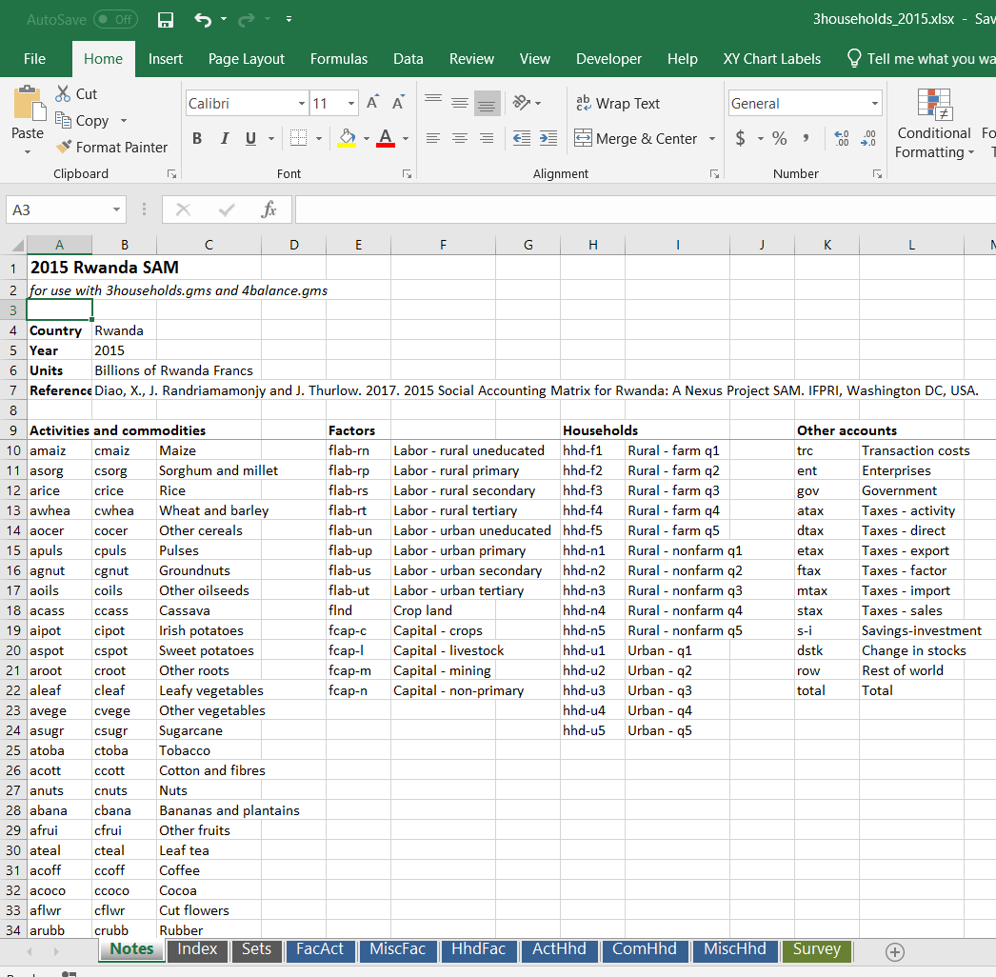
Household Excel File
More detailed factors and households
Blue sheets are imported into GAMS
Green sheet contains information from household and labor force surveys
3households.xlsx | Notes

Slide 38
Factor & Household Worksheets
FacAct Income generation (activity payments to factors)
MiscFac Non-activity receipts and payments for factors
HhdFac Income distribution (factor payments to households)
ActHhd Household own consumption shares
ComHhd Household marketed consumption shares
MiscHhd Non-commodity/factor transactions for households
Survey Raw data from surveys, transformed to Rwanda accounts
3households.xlsx | Notes

Slide 39
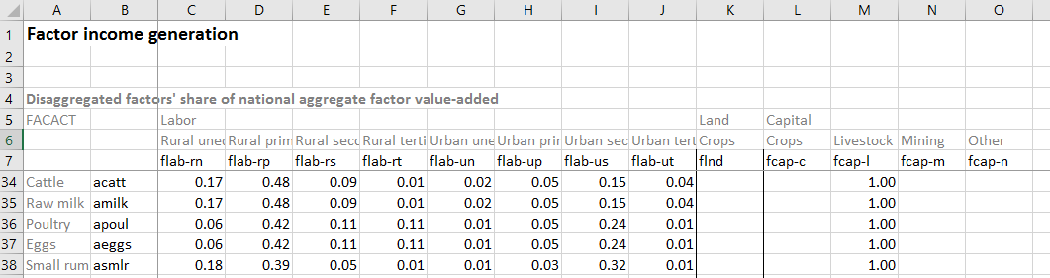
Income Generation Matrix
Share of each sector’s value added allocated to different factors
Within labor (8 types) and within capital (4 types)
Data from labor force and/or household surveys
Information on sectoral employment, including earnings from wages, nonfarm enterprises, an crop and livestock production
Raw survey data imported and adjusted on “Survey” sheet
3households.xlsx | FacAct
Labor earnings (sums to 1)

Slide 40
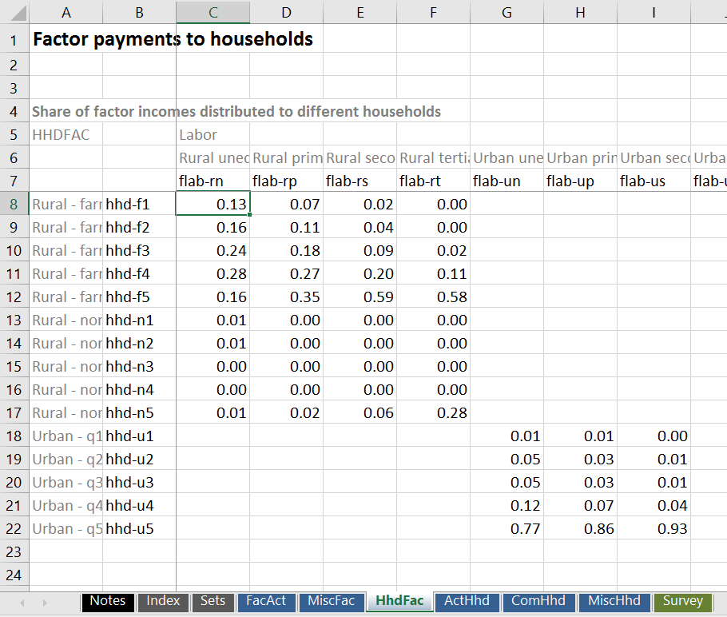
Income Distribution Matrix
Share of each factor’s earnings distributed to different households
13 factors across 15 households
Household survey data
On Survey sheet
Adjustments needed to avoid outliers
Also on Survey sheet
3households.xlsx | HhdFac
Factor payments (sums to 1 across households)

Slide 41
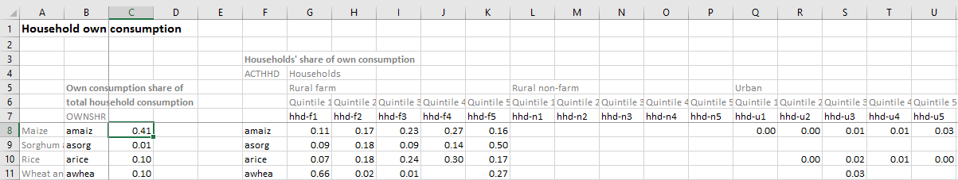
Household Consumption Matrices
Data on own & marketed consumption (ActHhd & ComHhd)
Share of each product’s total consumption demand generated by different households
30 commodities across 15 households
Household survey data
On Survey sheet
3households.xlsx | ActHhd
Product consumption shares (sum to 1)

Slide 42
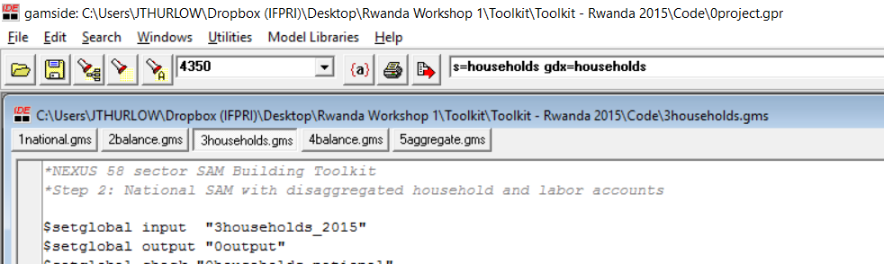
Building the Household SAM in GAMS
Click on household SAM build file (3households.gms)
Check that you are using the correct data file (3households_2015)
Press F9 (or click on Run Button)
Check process window (Normal Completion)
3households.gms
1national.gms

Slide 43
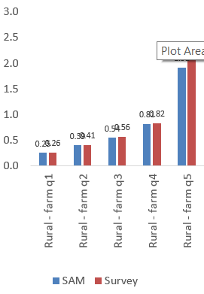
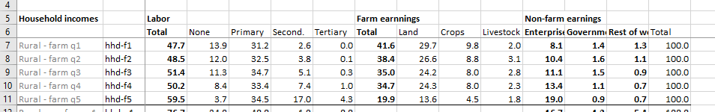
Household Imbalances
Check 0households_national.xlsx
Household information
Income shares across factors & other sources
Comparison of survey vs. SAM per capita consumption
Household incomes vs. expenditures
0households.xlsx | Workings

Slide 44
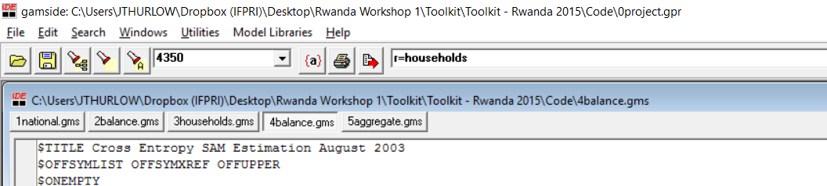
Balancing the SAM in GAMS
Click on SAM balancing file (4balance.gms)
Check you are restarting from the previous file (r=households)
Press F9 (or click on Run Button)
Check process window (Optimal Solution & Normal Completion)
4balance.gms

Slide 45
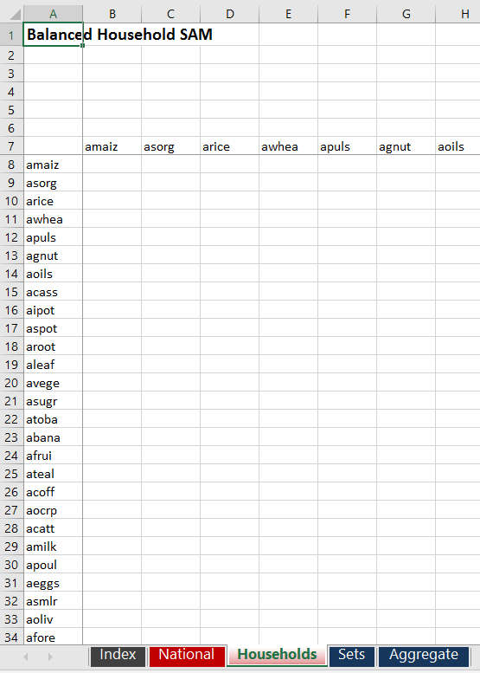
Viewing Balanced Household SAM
0output.xlsx | Household sheet
Balanced SAMs are exported to the 0results.xlsx file
Check 0households_national.xlsx again to see how income and expenditure share changed during balancing

